Slide 1

Python Bytes
Parent Info Night
From Beginner to Advanced Coder in 7 months

Slide 2
Agenda
Goal of the Python Byte Club - Why Coding, Why Python
Coaches & Volunteers
New Format - In person, Hands on Activity based learning
Plan - syntax, practice, team, project, forum via Discord
Registration Information

Slide 3
Goal
Invoke students’ interest into coding
Coaching on Programming Concepts with hands on activities
Teaching Python Language Fundamentals
Convert Ideas to Python Code and then to Projects
Study group
Allow students to advance at their own pace

Slide 4
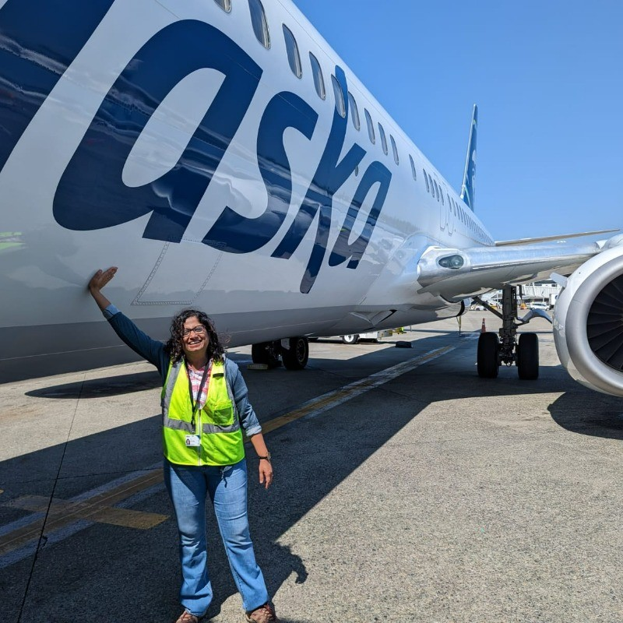
Co-Chairs
Reji Dasan has a Bachelor's degree in Computer Science & Engineering and has been coding professionally for the past 17+ years. She has worked with several companies and is currently working as a Principal Software Engineer with Alaska Airlines at SeaTac. She is passionate about anything Computer Science and believes that every child should know how to code.
Yunzhao Li has a PhD degree in Computer Engineering from Kansas State University. He has worked as a software engineer for over ten years now. He is very excited about this opportunity to contribute to our Python club and to the broader Tyee community.

Slide 5
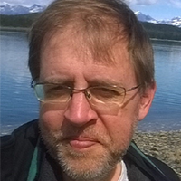
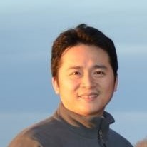
Head Coaches, Advisors & Mentors
Rob Fatland
is the UW Director of Cloud and Data Solutions. He has formerly worked at NASA and Microsoft Research and has a PhD in Geophysics. His interests are in data science across the full spectrum from acquisition to collaboration with emphases on remote sensing, sensor networks, visualization, data systems and (domain-wise) the earth’s hydrosphere. He also devotes time and energy to K12 STEM education.
Wei Lu After earning his Ph.D. in computer science, Wei Lu promptly embarked on his career at Microsoft, where he has been a dedicated member of various teams, from Microsoft Research to Bing, for over a decade. He currently serves as a Principal Engineer at Coupang, specializing in distributed systems, big data, and machine learning.

Slide 6
The volunteer team - so far...
Co-Chairs: Reji Dasan, Yunzhao Li
Advisors & Head Coaches:
Rob Fatland (Lead Coach and Curriculum Director)
Wei Lu (Lead Coach and Advisor)
Aadya Rangole (Lead Coach)
Coaches: Nandini, Dhruv, Rhea, Varun, Jeffrey, Adarsh, Nikita, Pranav, Esther, Sidd, Advik

Slide 7
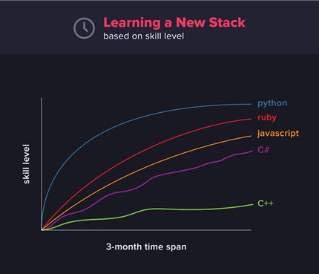
Why Python? 5 reason to learn Python
JAVA
public class HelloWorld {
public static void main(String[] args) {
System.out.println("I’m awesome");
}
}
C++
#include <iostream>
int main() {
std::cout << "I’m awesome.\n";
}
Python
print(“I’m awesome”)

Slide 8
5 reason to learn Python
2. Useful: Once you learn it you can find opportunities in Automation, Web development, Data Science, Machine
Learning, AI, Web Scraping, Game Development
3. Value and Demand
4. Community & Open Source
5. Resources - over 125,000 third-party Python libraries
If you want to learn coding, but haven’t decided what to do with it, then Python is the obvious option; as it gives you a choice to switch between different fields with its flexibility.

Slide 9
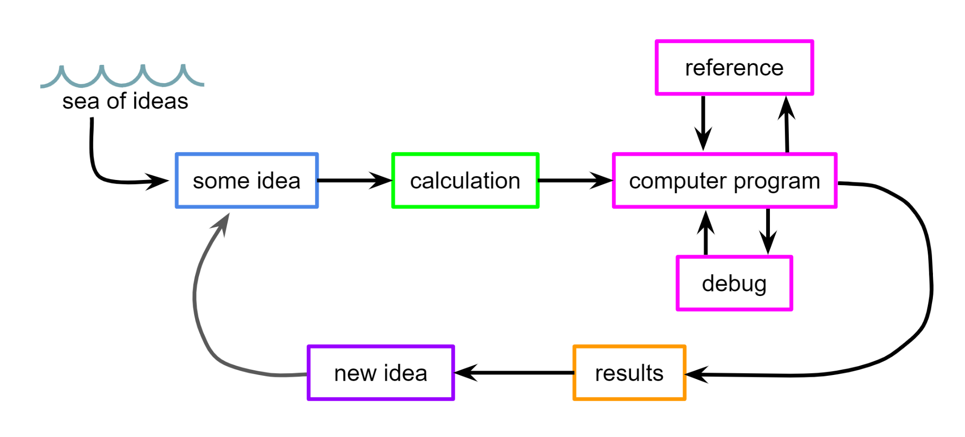
Why Coding? Convert Ideas into Projects

Slide 10
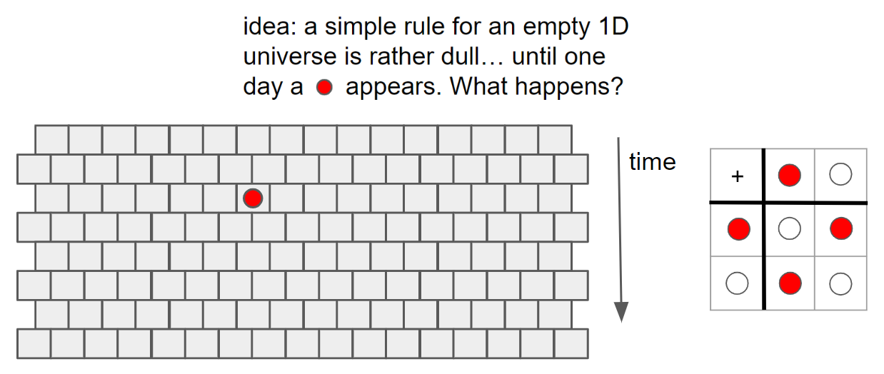
Convert Ideas into Projects

Slide 11
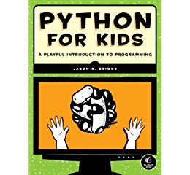
Plan
Classroom: Discuss concepts and ideas and hands-on activities to understand the concepts
Study group:
Review the Python syntax
Code the ideas into projects using Python
Have fun
Online coding Platform: https://replit.com/

Slide 12
Plan cont.
Project: Small Group Projects using repl.it online IDE or python IDE
Discord: Online communication Server to collaborate.
Team coach to help team:
Learn Python along with kids.
Remind them to use the pdf book to delve deeper and refer for syntax etc.
Coach the team to implement the idea, solve the puzzle, complete the project, make progress.
Help team to ask clear questions (in session or over Discord).

Slide 13
Requirements & Logistics
Need a personal laptop (school laptop would not work)
Year Long Club - meets every Wednesday @Tyee In-person 7:00 - 8:30 p.m.
Follows BSD Calendar, Breaks and Holidays
Tyee PTSA membership

Slide 14
Programming Competition Club - Johannes Grad
What is the Programming Competition Club?
The starting point to compete.
Multi-year effort in programming competition preparation.
Registration Info: Please attend Parent Info Night on 9/28 at 7:00 p.m. Check Tyee Times for details
Contact programcomp@tyeeptsa.org for more information

Slide 15
Registration - Python Bytes Club
Seats available: 50
Registration Fee : $50 (non-refundable)
Scholarships available
Tyee PTSA membership required prior to registration (please join or renew here https://tyeeptsa.org/)
Contact pythonclub@tyeeptsa.org for additional information

Slide 16
Important Dates
Registration Opens: TODAY!! (Wednesday, Sept 27) @ 8:00 p.m
Registration Link: https://tyeeptsa.org/Page/PROGRAM%20PAGES/Python%20Bytes%20Club
Registration Closes: Oct 4th 8:00 p.m or 50 student count
First Day of Club: Oct 18th 7:00 - 8:30 p.m
Contact pythonclub@tyeeptsa.org for additional information

